Slide 1
Searching for signs of resilience in over-wintering juvenile pteropods to ocean acidification and deoxygenation
Shelly Trigg, Ph.D.
School of Aquatic and Fishery Sciences
University of Washington
NOAA Collaborators: Krista Nichols, Shallin Busch, Paul McElhany, Michael Maher, Danielle Perez, Caitlin O’Brien
NWFSC Montlake and Mukilteo Research Station,
Conservation Biology Division, Genetics Section

Slide 2
How does ocean change affect Pteropods?
Sensitivity in the lab and field
Resilience in the field
Puget Sound winter conditions
List some examples from lit
Low O2
Low pH, aragonite
Low food availability
Notes:
The planktonic pteropod is an important ecological species with roles in marine food webs, oceanic carbon cycling, and potentially serving as an indicator of ocean acidification. Although lab and field studies have shown pteropods are sensitive to ocean acidification conditions, in Puget Sound these organisms have been coping with low oxygen and aragonite saturation conditions during winters when food availability is low.

Slide 3
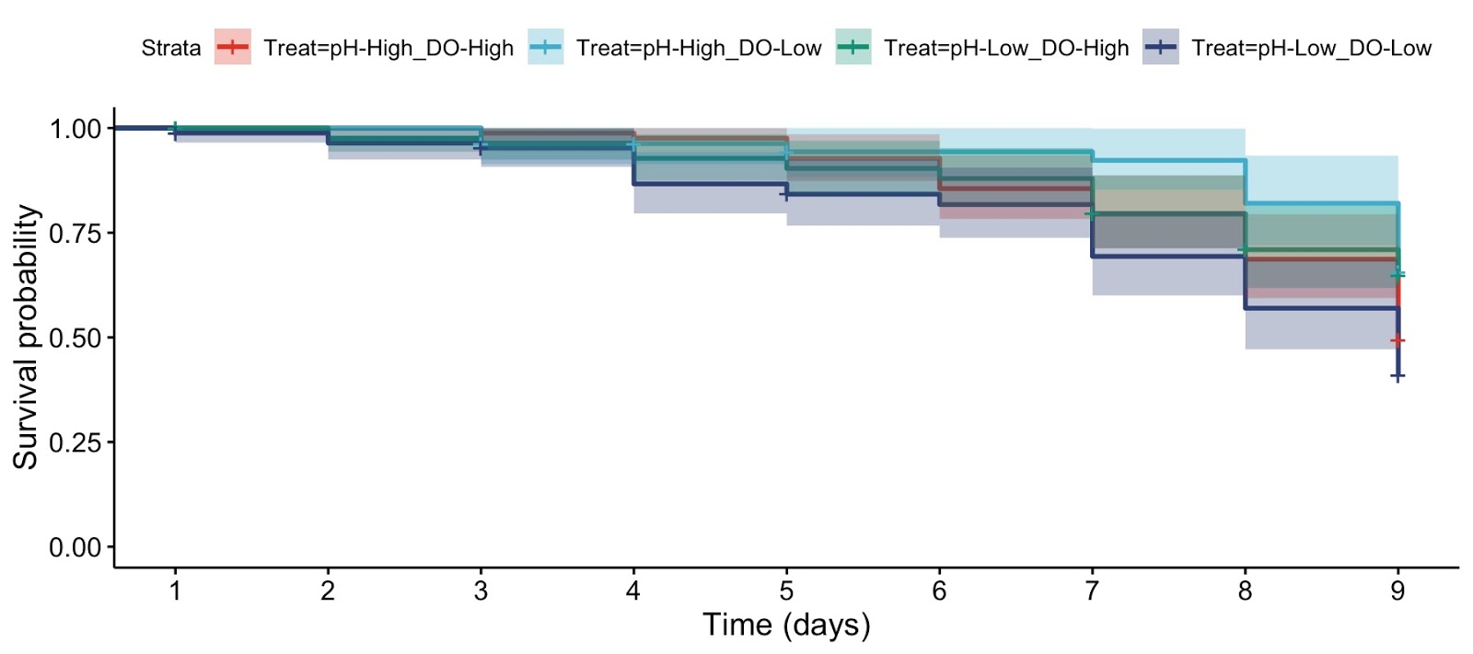
Altering pH and O2 in lab environment
pH x DO 2-factor experiment
survival
pH
ambient
low
100% O2
pH 7.95
100% O2
pH 7.55
ambient
O2
low
40% O2
pH 7.95
40% O2
pH 7.55
Survival highest under single stress, lowest under combined stress
Combined stress had a weakly significant effect
0
days
9
juveniles exposed for 9 days
Notes:
Confidence intervals are largely overlapping

Slide 4
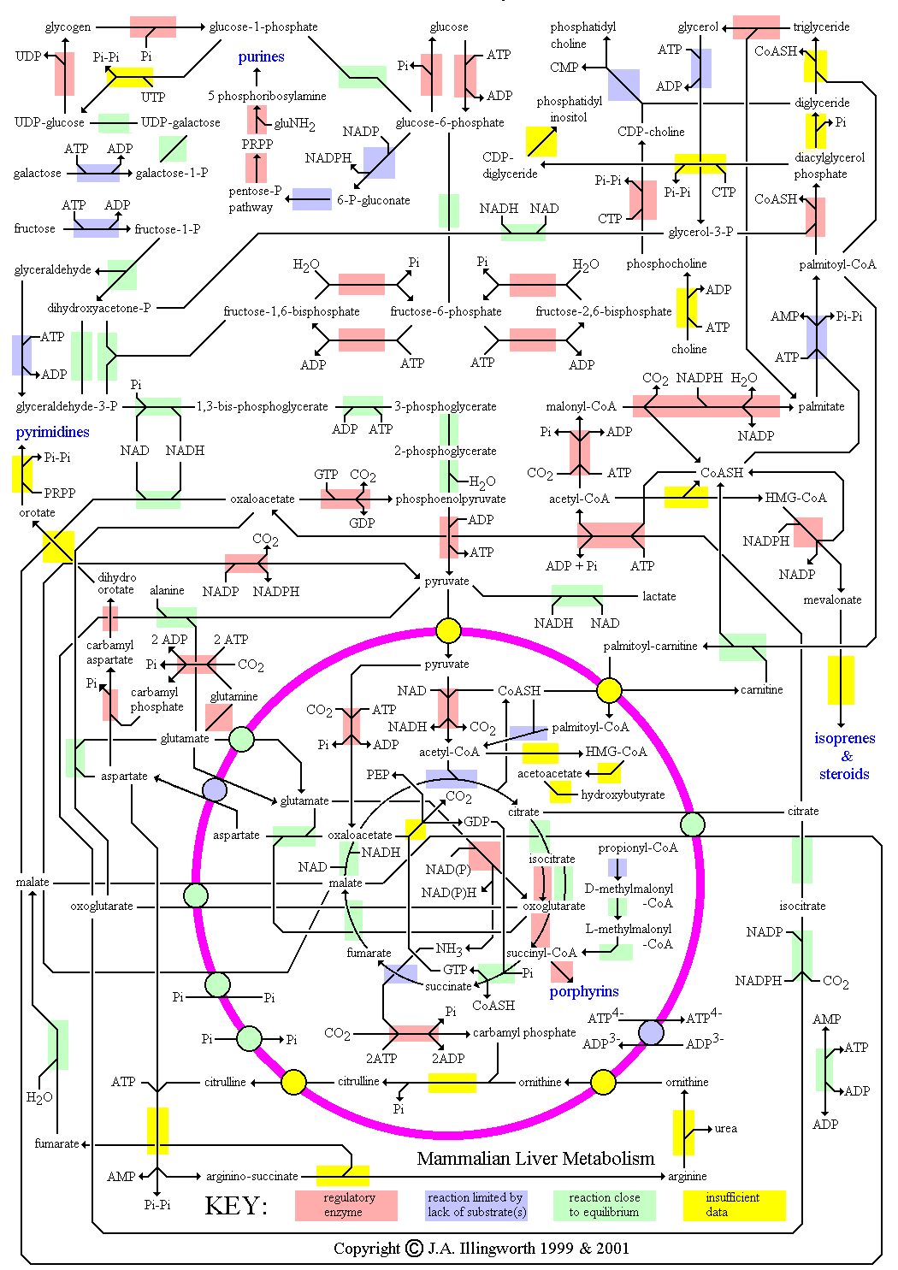
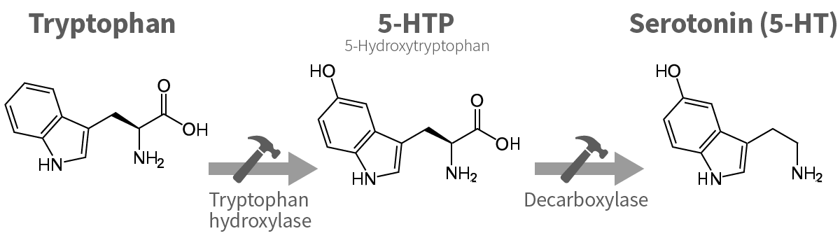
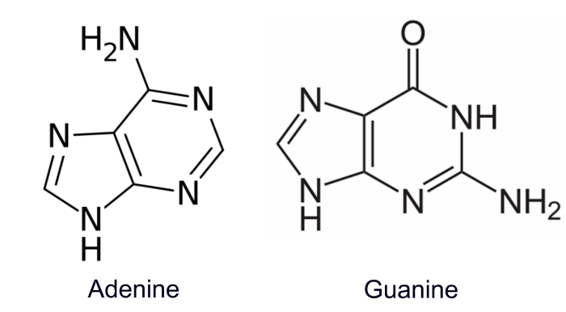
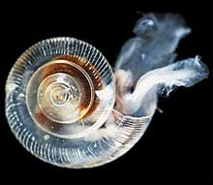
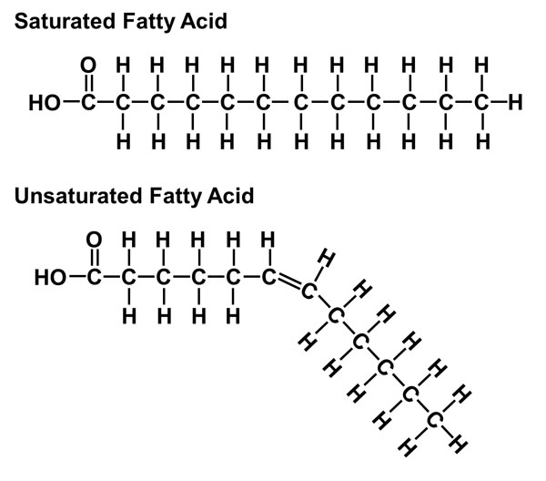
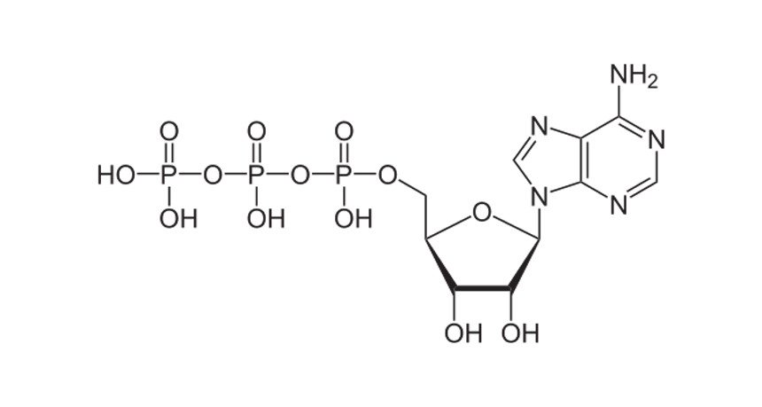
Metabolomics for physiological insight
Animals exposed to different conditions
Identify all metabolites
Infer activity of pathways
Guanine
BIOSIGNALING
PATHWAYS
Tryptophan
NUCLEIC ACID METABOLISM
ENERGY
METABOLISM
Glucose
Fatty Acids
CARBOHYDRATE METABOLISM
Norm pH
Norm O₂
ATP
AMINO ACID METABOLISM
Low O₂
Low pH
Low pH
Low O₂
LIPID
METABOLISM
VITAMIN
METABOLISM

Slide 5
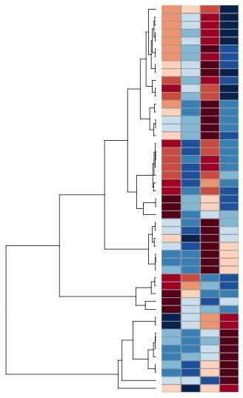
Low O2 more strongly affects metabolites
Low O2
Low O2 + pH
ambient
Low pH

Slide 6
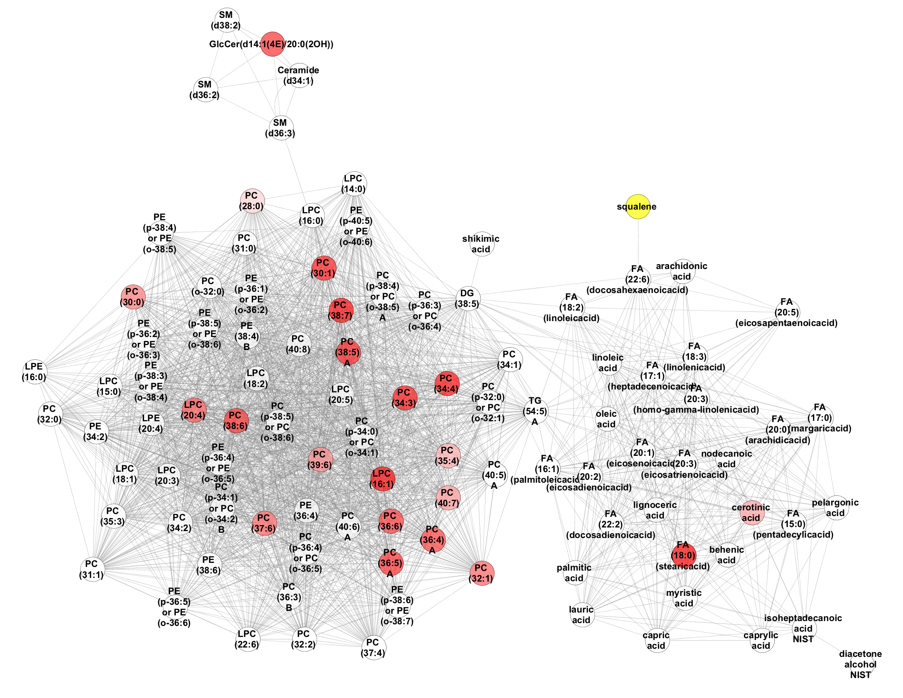
Phosphotidylcholines are significantly affected

Slide 7
Summary

